Slide 1
Mathematical Description of Continuous-Time Signals
M. J. Roberts - All Rights Reserved. Edited by Dr. Robert Akl

Slide 2
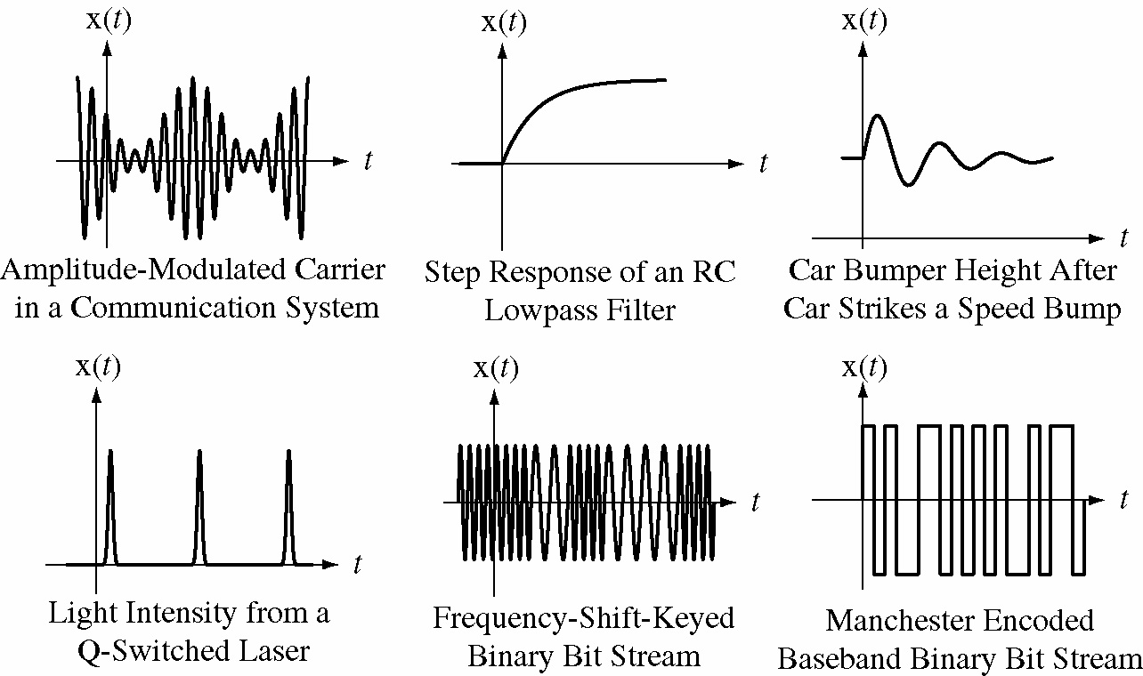
Typical Continuous-Time Signals
M. J. Roberts - All Rights Reserved. Edited by Dr. Robert Akl
‹#›

Slide 3
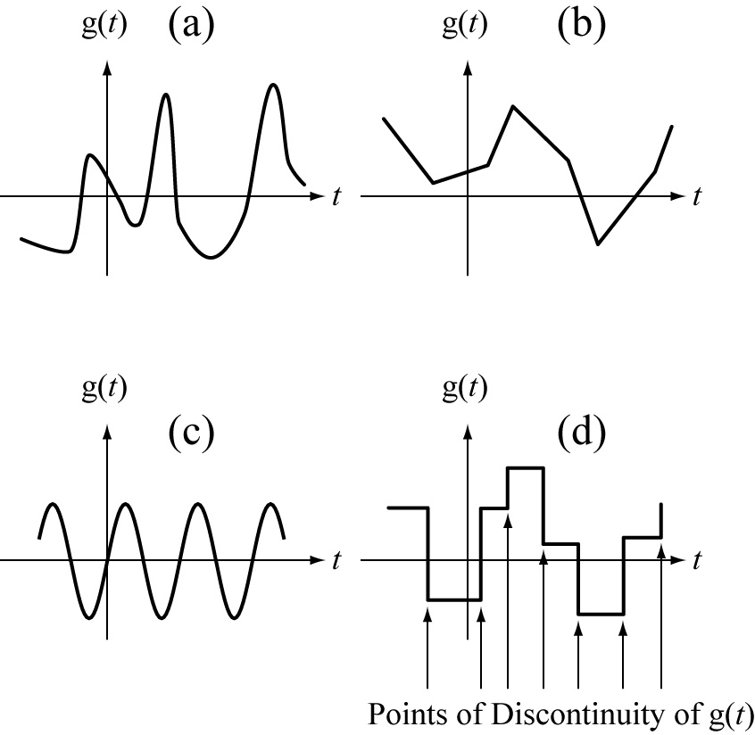
Continuous vs Continuous-Time Signals
All continuous signals that are functions of time are
continuous-time but not all continuous-time signals are
continuous
M. J. Roberts - All Rights Reserved. Edited by Dr. Robert Akl
‹#›

Slide 4
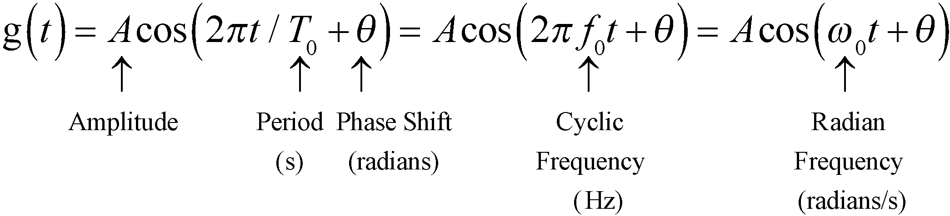
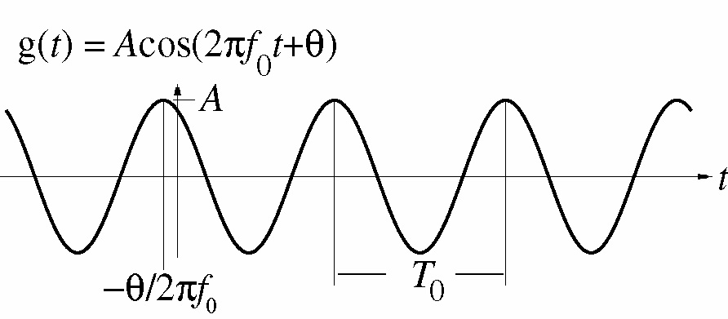
Continuous-Time Sinusoids
M. J. Roberts - All Rights Reserved. Edited by Dr. Robert Akl
‹#›

Slide 5
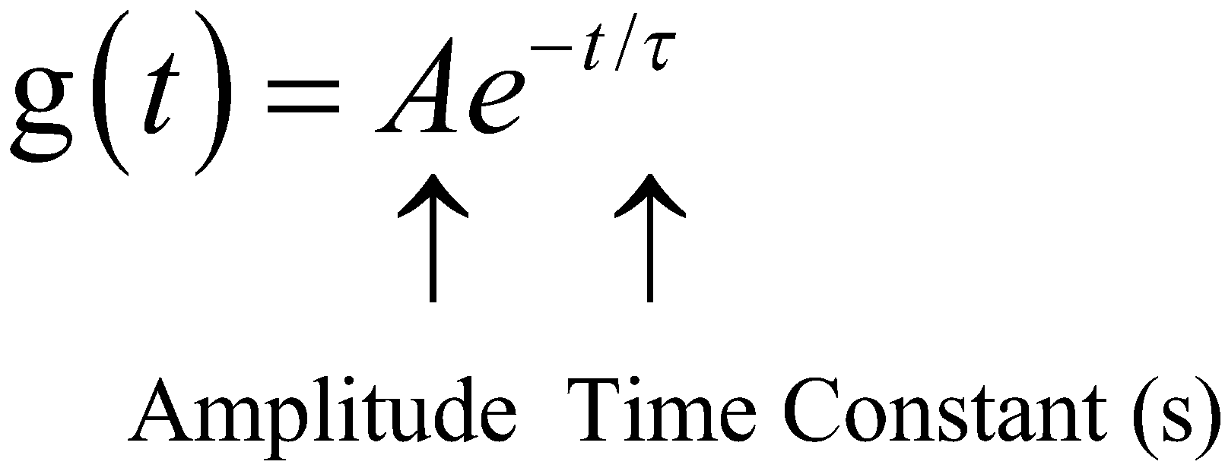
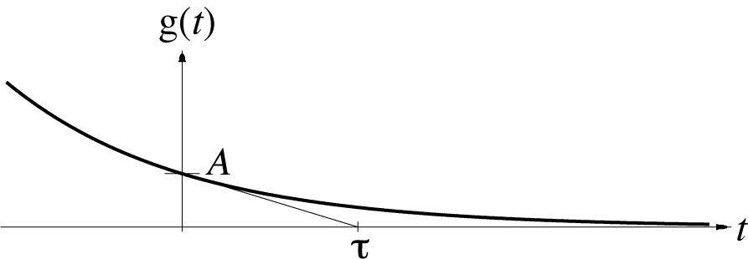
Continuous-Time Exponentials
M. J. Roberts - All Rights Reserved. Edited by Dr. Robert Akl
‹#›

Slide 6
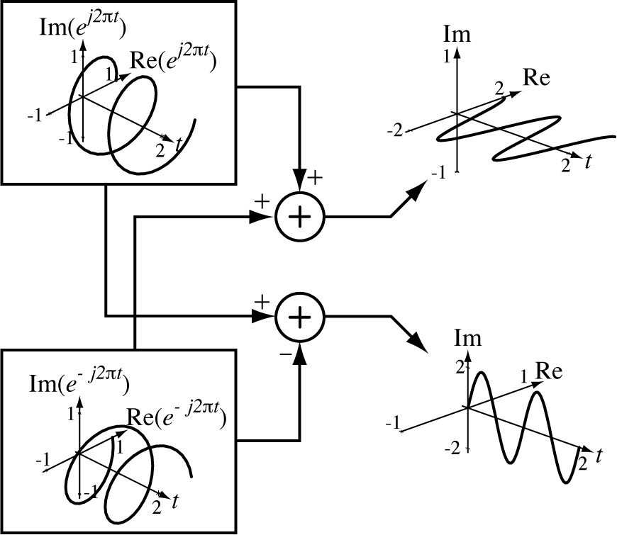
Complex Sinusoids
M. J. Roberts - All Rights Reserved. Edited by Dr. Robert Akl
‹#›

Slide 7
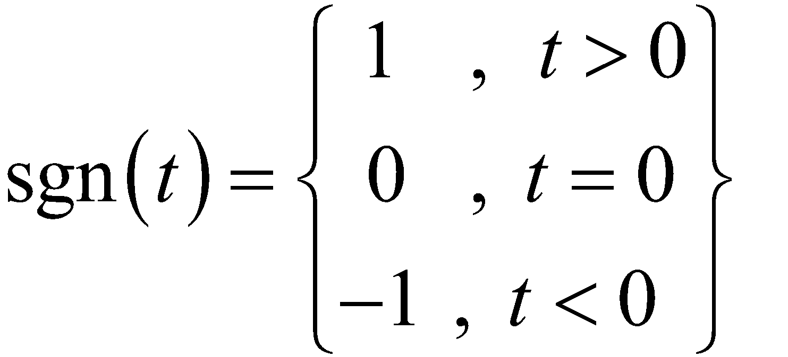
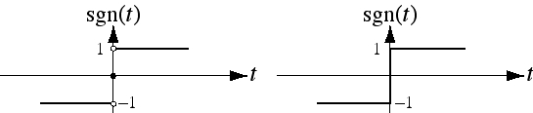
The Signum Function
Precise Graph
Commonly-Used Graph
The signum function, in a sense, returns an indication of
the sign of its argument.
M. J. Roberts - All Rights Reserved. Edited by Dr. Robert Akl
‹#›

Slide 8
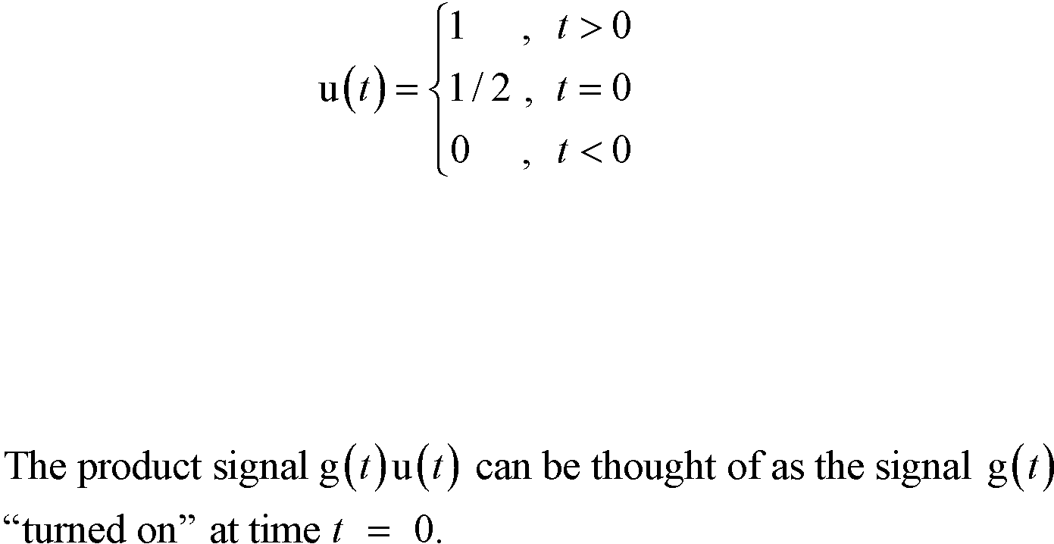
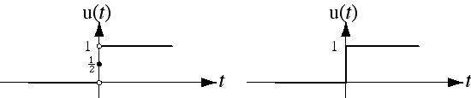
The Unit Step Function
M. J. Roberts - All Rights Reserved. Edited by Dr. Robert Akl
‹#›

Slide 9
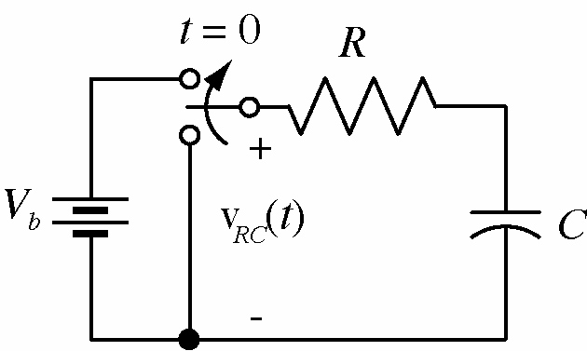
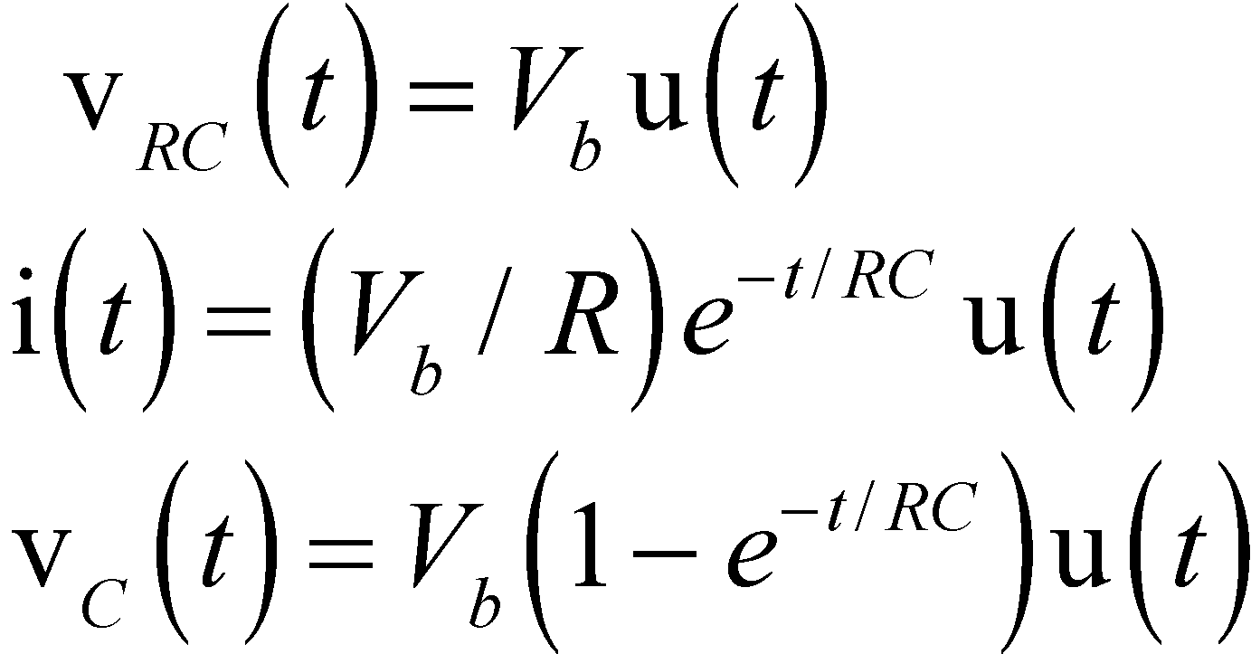
The Unit Step Function
The unit step function can mathematically describe a
signal that is zero up to some point in time and non-
zero after that.
M. J. Roberts - All Rights Reserved. Edited by Dr. Robert Akl
‹#›

Slide 10
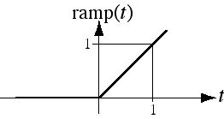
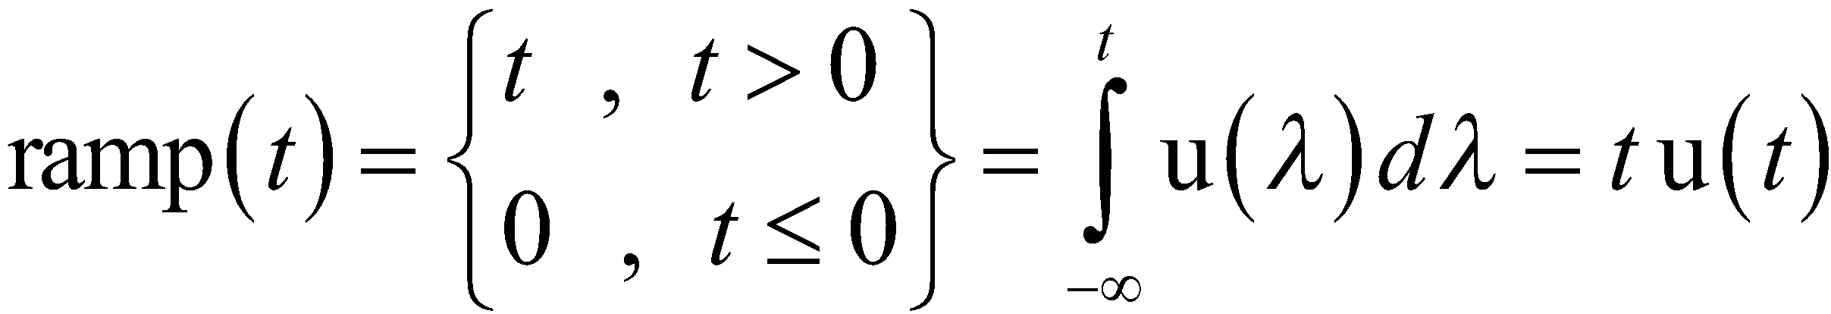
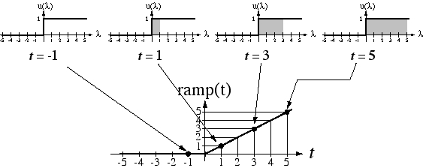
The Unit Ramp Function
M. J. Roberts - All Rights Reserved. Edited by Dr. Robert Akl
‹#›

Slide 11
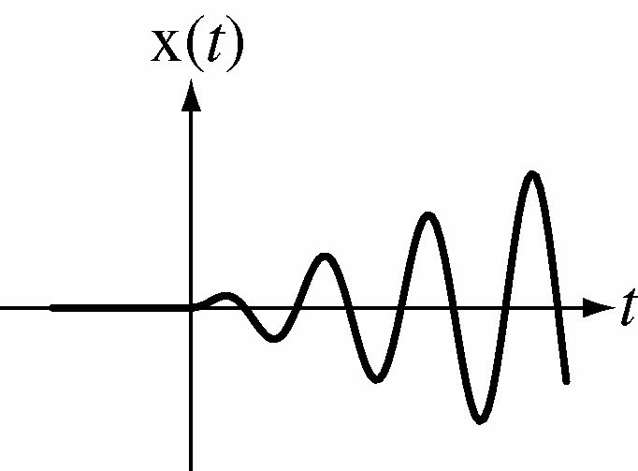
The Unit Ramp Function
Product of a sine wave and a ramp function.
M. J. Roberts - All Rights Reserved. Edited by Dr. Robert Akl
‹#›

Slide 12
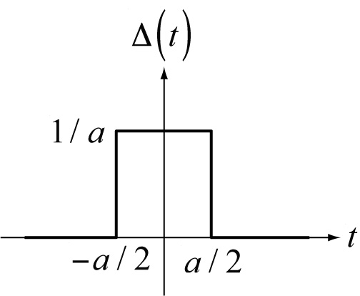
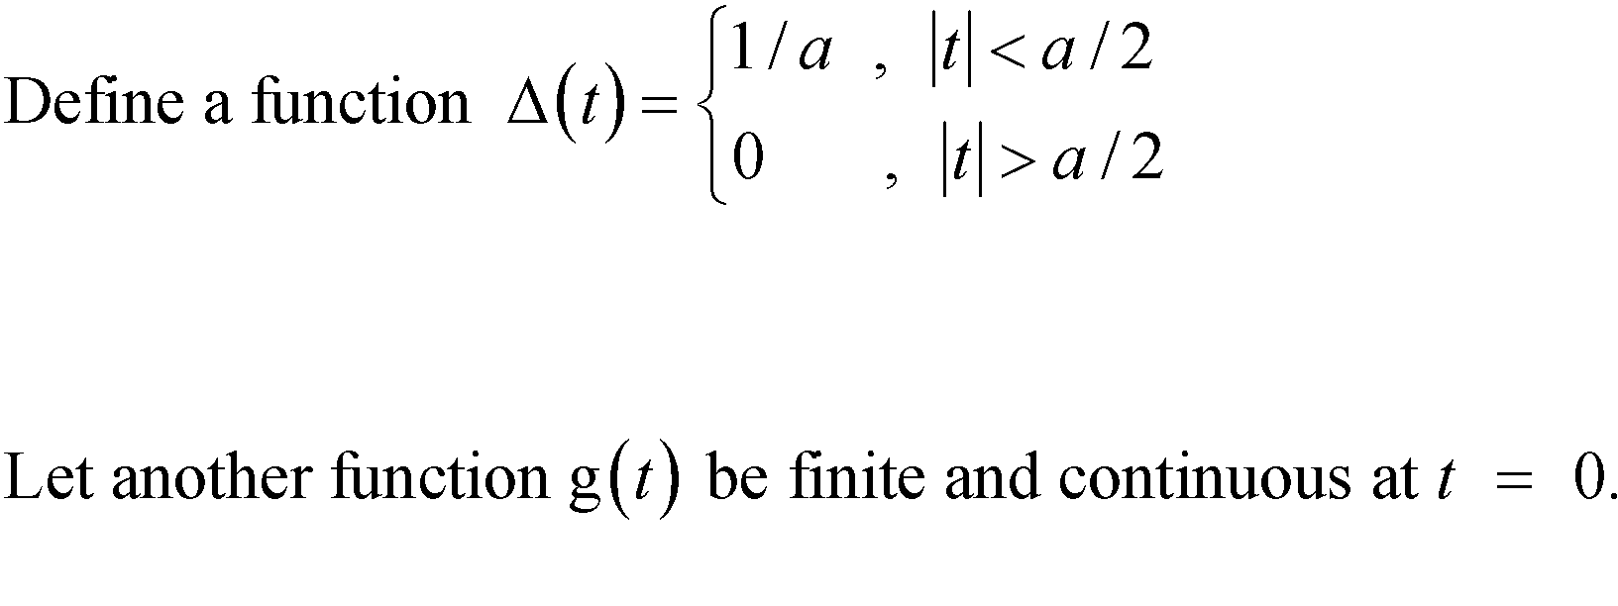
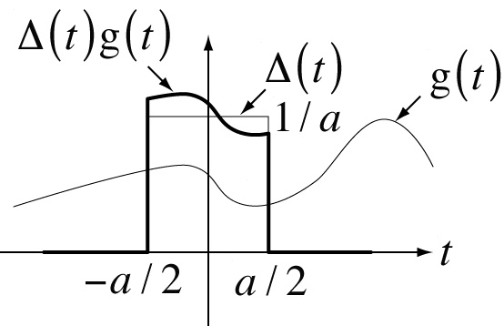
Introduction to the Impulse
M. J. Roberts - All Rights Reserved. Edited by Dr. Robert Akl
‹#›

Slide 13
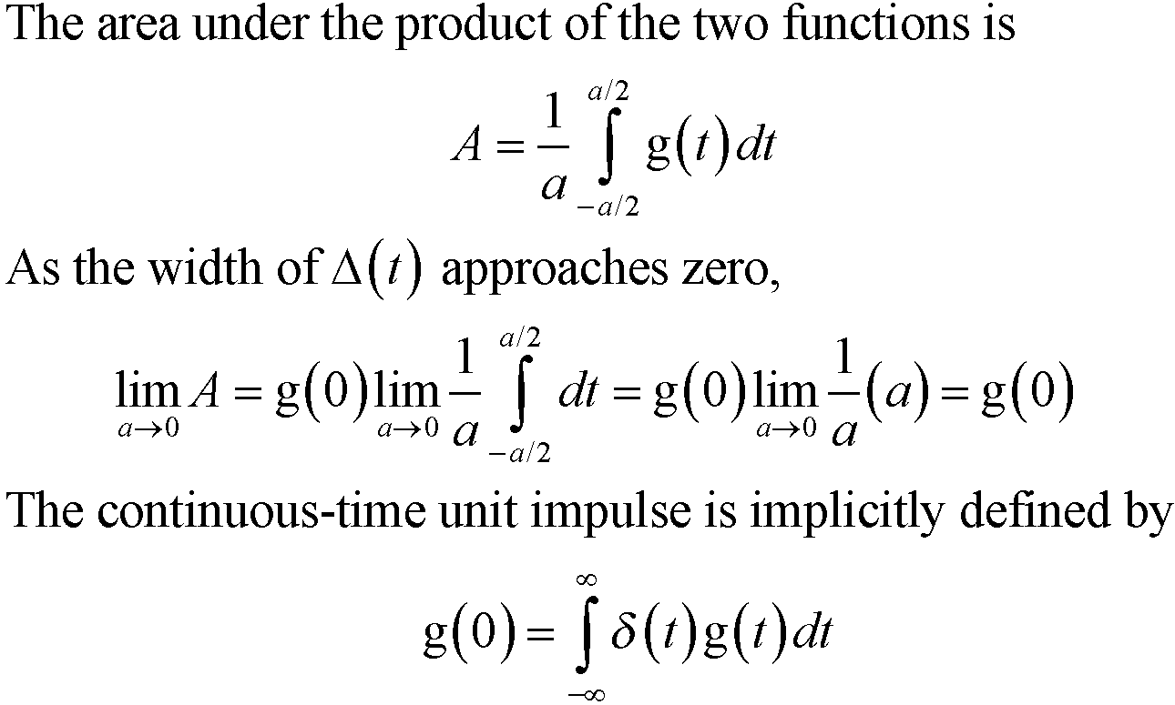
Introduction to the Impulse
M. J. Roberts - All Rights Reserved. Edited by Dr. Robert Akl
‹#›

Slide 14
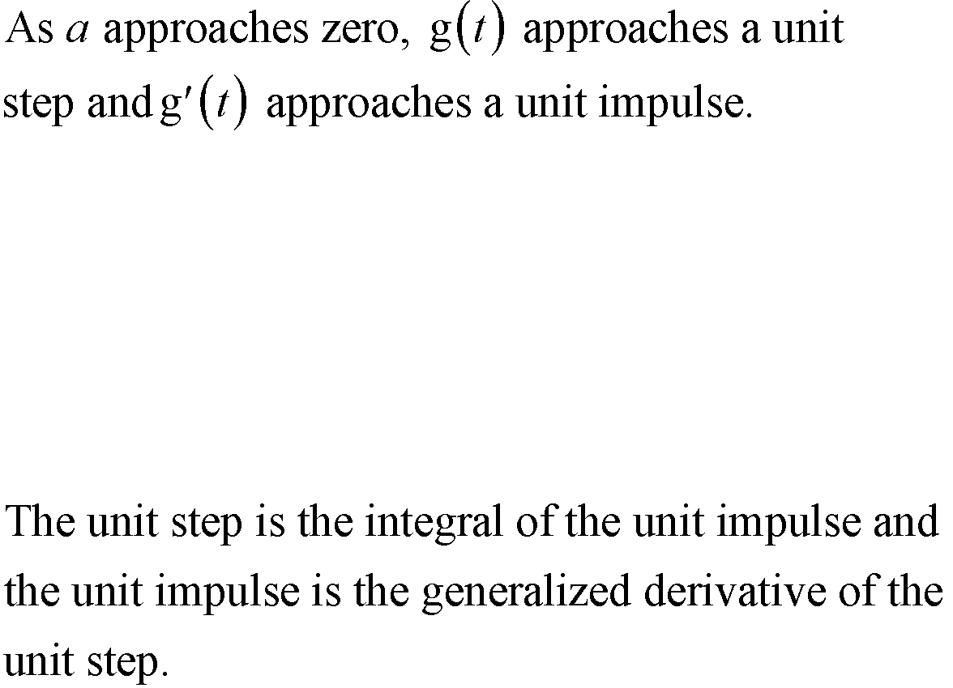
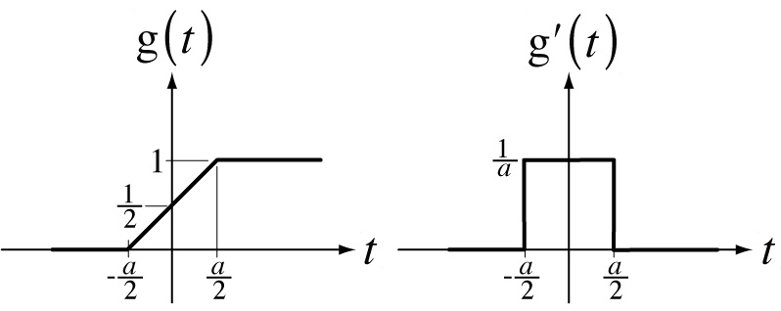
The Unit Step and Unit Impulse
M. J. Roberts - All Rights Reserved. Edited by Dr. Robert Akl
‹#›

Slide 15
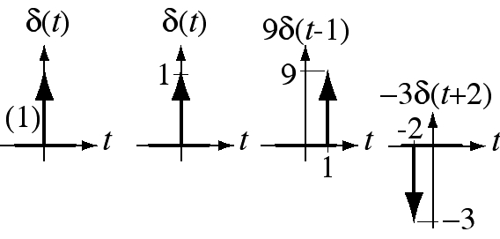
Graphical Representation of the Impulse
The impulse is not a function in the ordinary sense because its
value at the time of its occurrence is not defined. It is represented
graphically by a vertical arrow. Its strength is either written beside
it or is represented by its length.
M. J. Roberts - All Rights Reserved. Edited by Dr. Robert Akl
‹#›

Slide 16
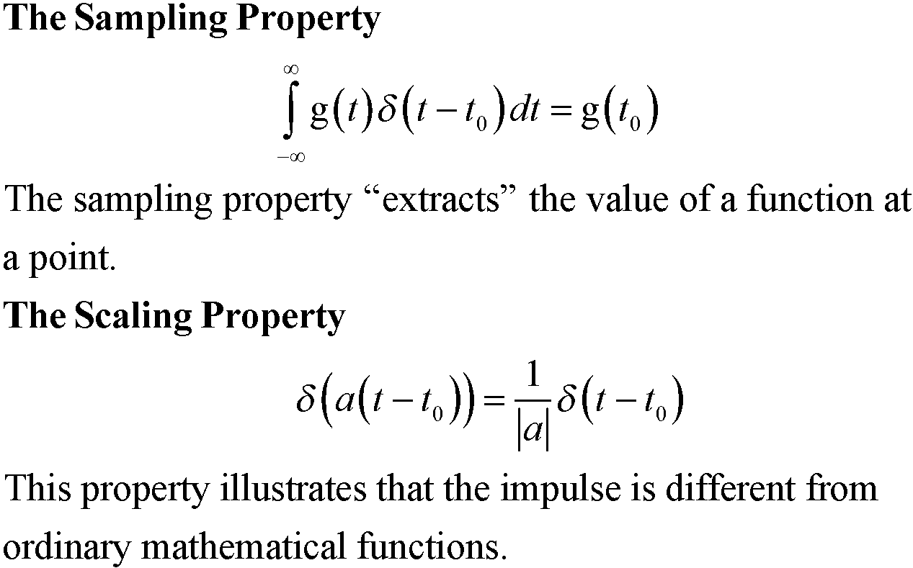
Properties of the Impulse
M. J. Roberts - All Rights Reserved. Edited by Dr. Robert Akl
‹#›

Slide 17
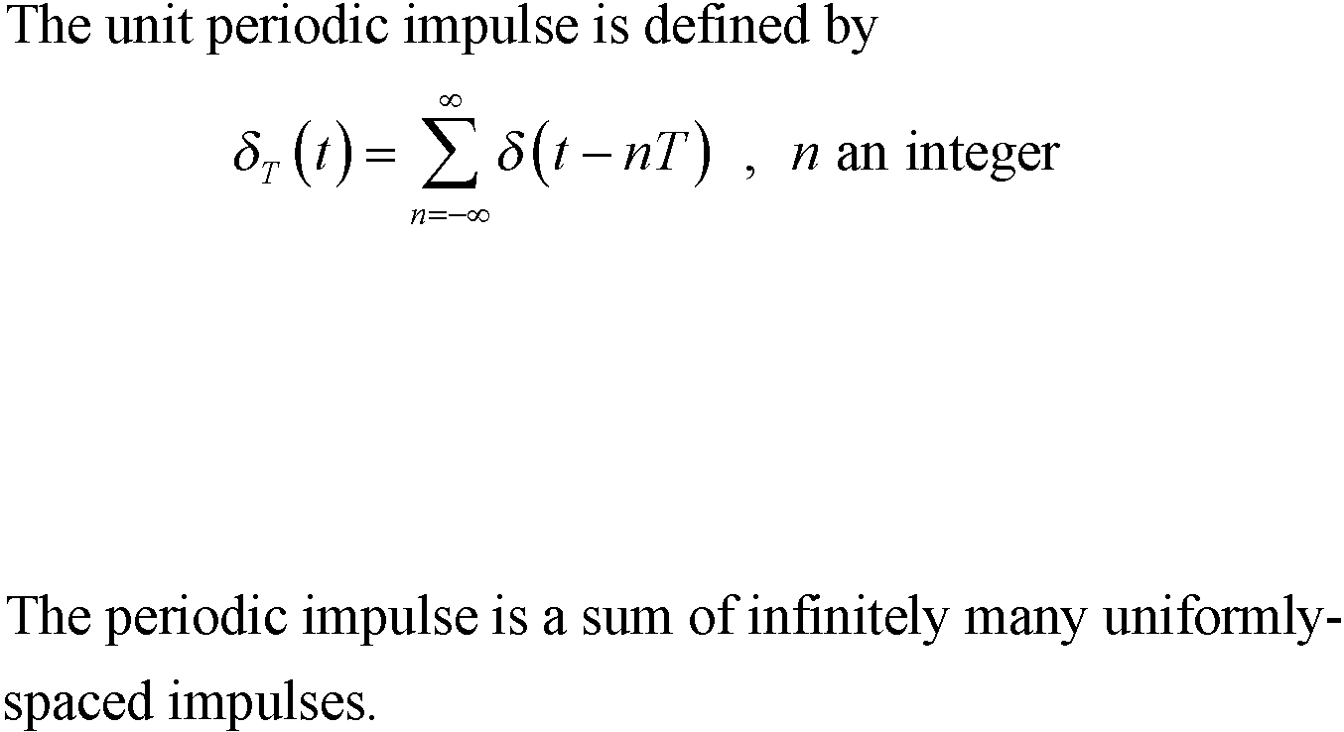
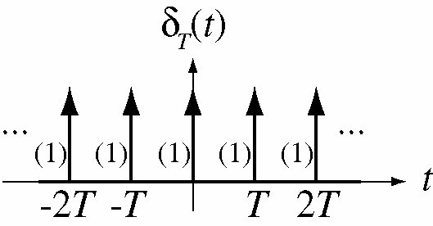
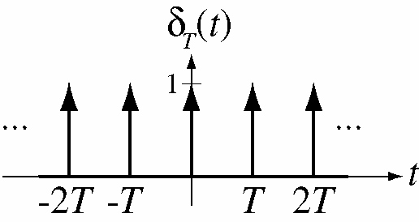
The Unit Periodic Impulse
M. J. Roberts - All Rights Reserved. Edited by Dr. Robert Akl
‹#›

Slide 18
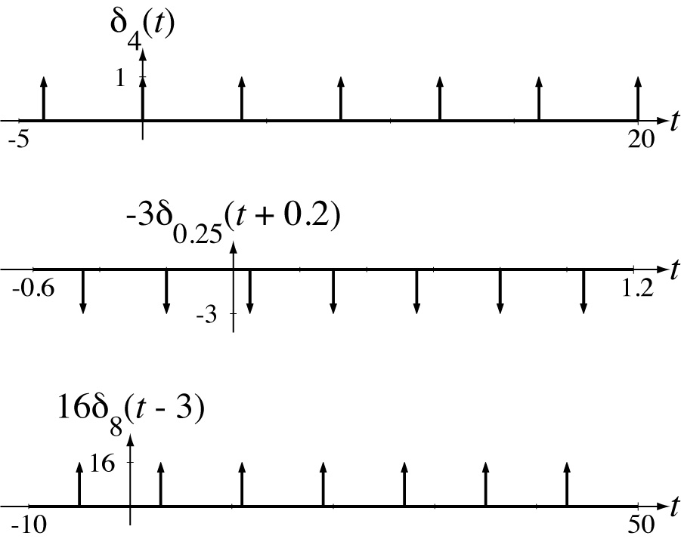
The Periodic Impulse
M. J. Roberts - All Rights Reserved. Edited by Dr. Robert Akl
‹#›

Slide 19
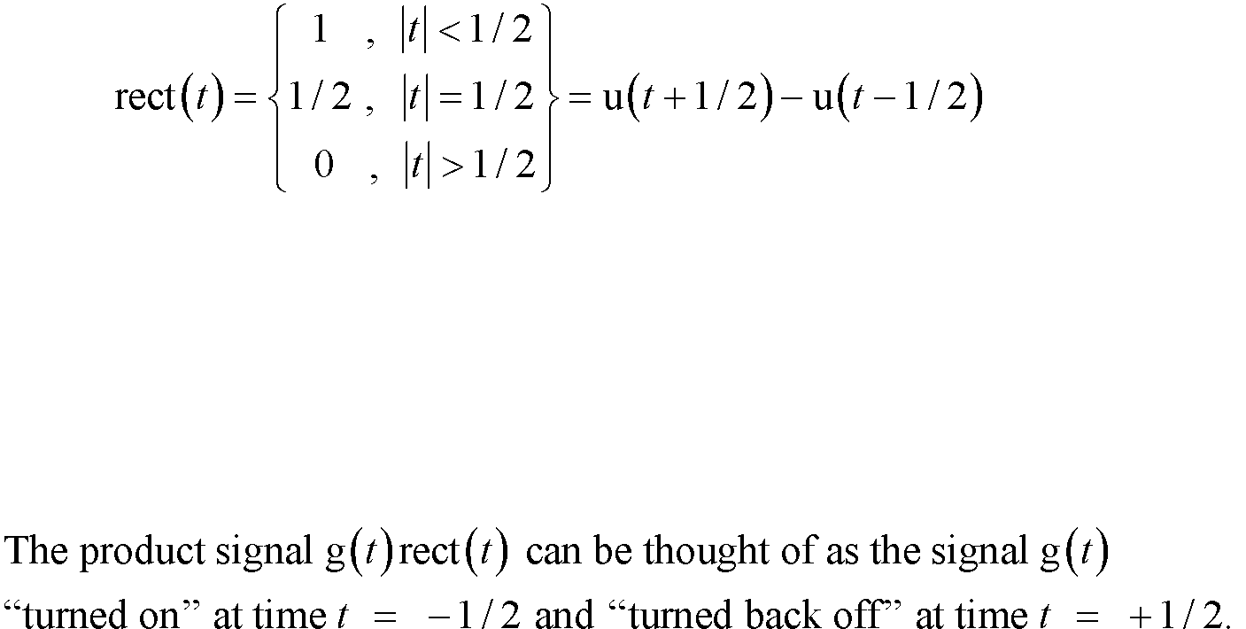
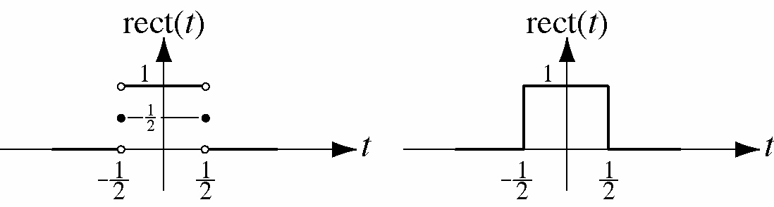
The Unit Rectangle Function
M. J. Roberts - All Rights Reserved. Edited by Dr. Robert Akl
‹#›

Slide 20
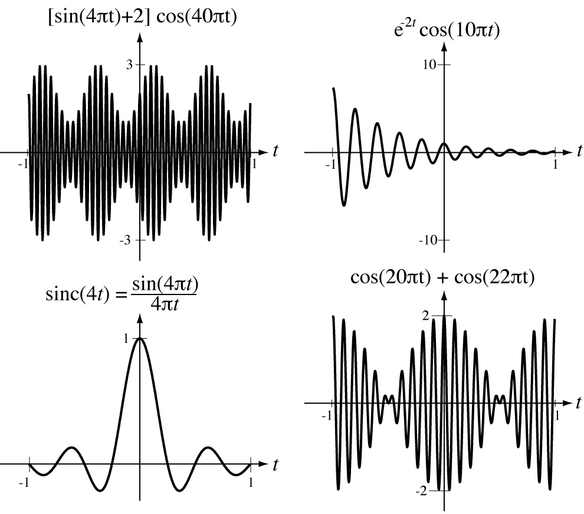
Combinations of Functions
M. J. Roberts - All Rights Reserved. Edited by Dr. Robert Akl
‹#›

Slide 21
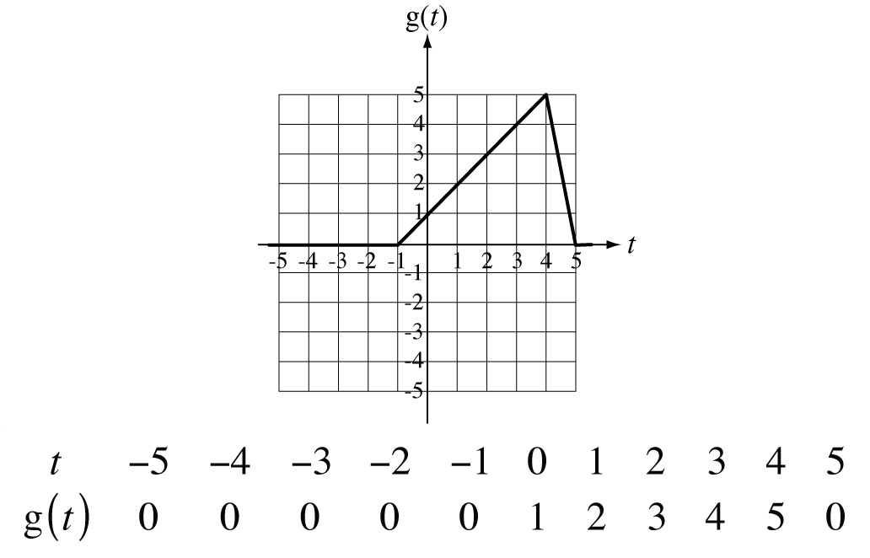
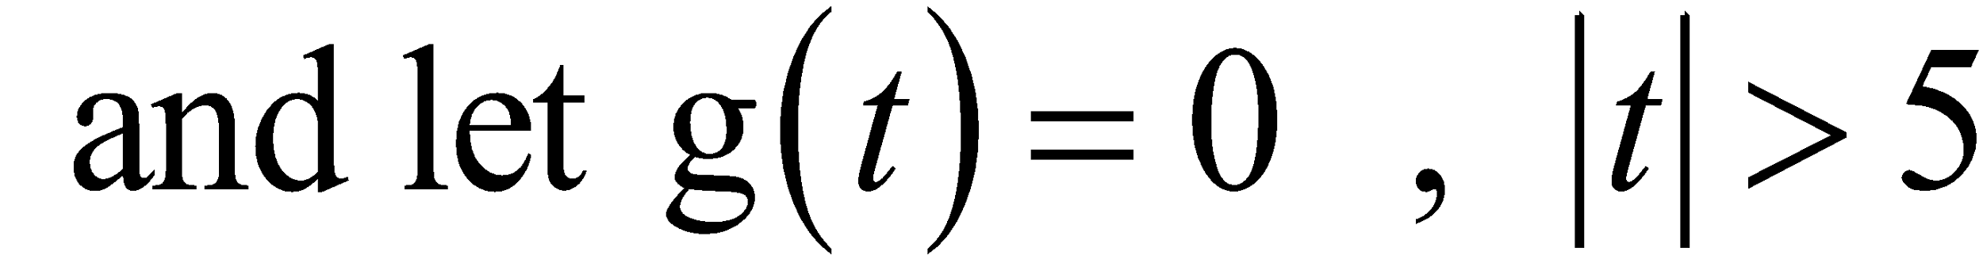
Shifting and Scaling Functions
Let a function be defined graphically by
M. J. Roberts - All Rights Reserved. Edited by Dr. Robert Akl
‹#›

Slide 22
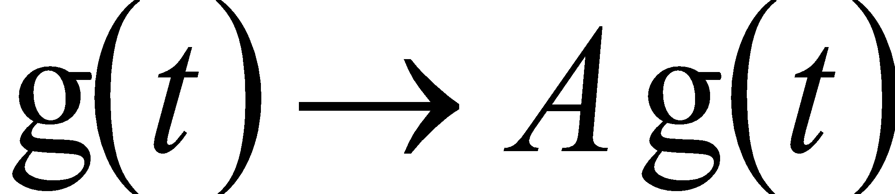
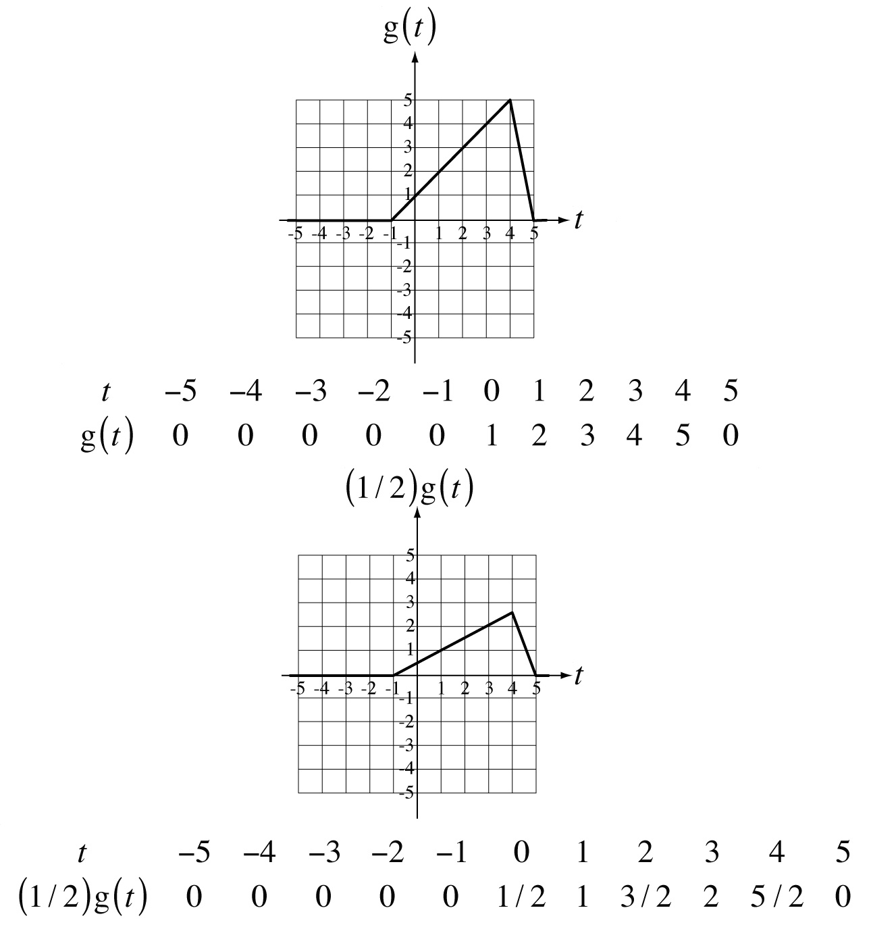
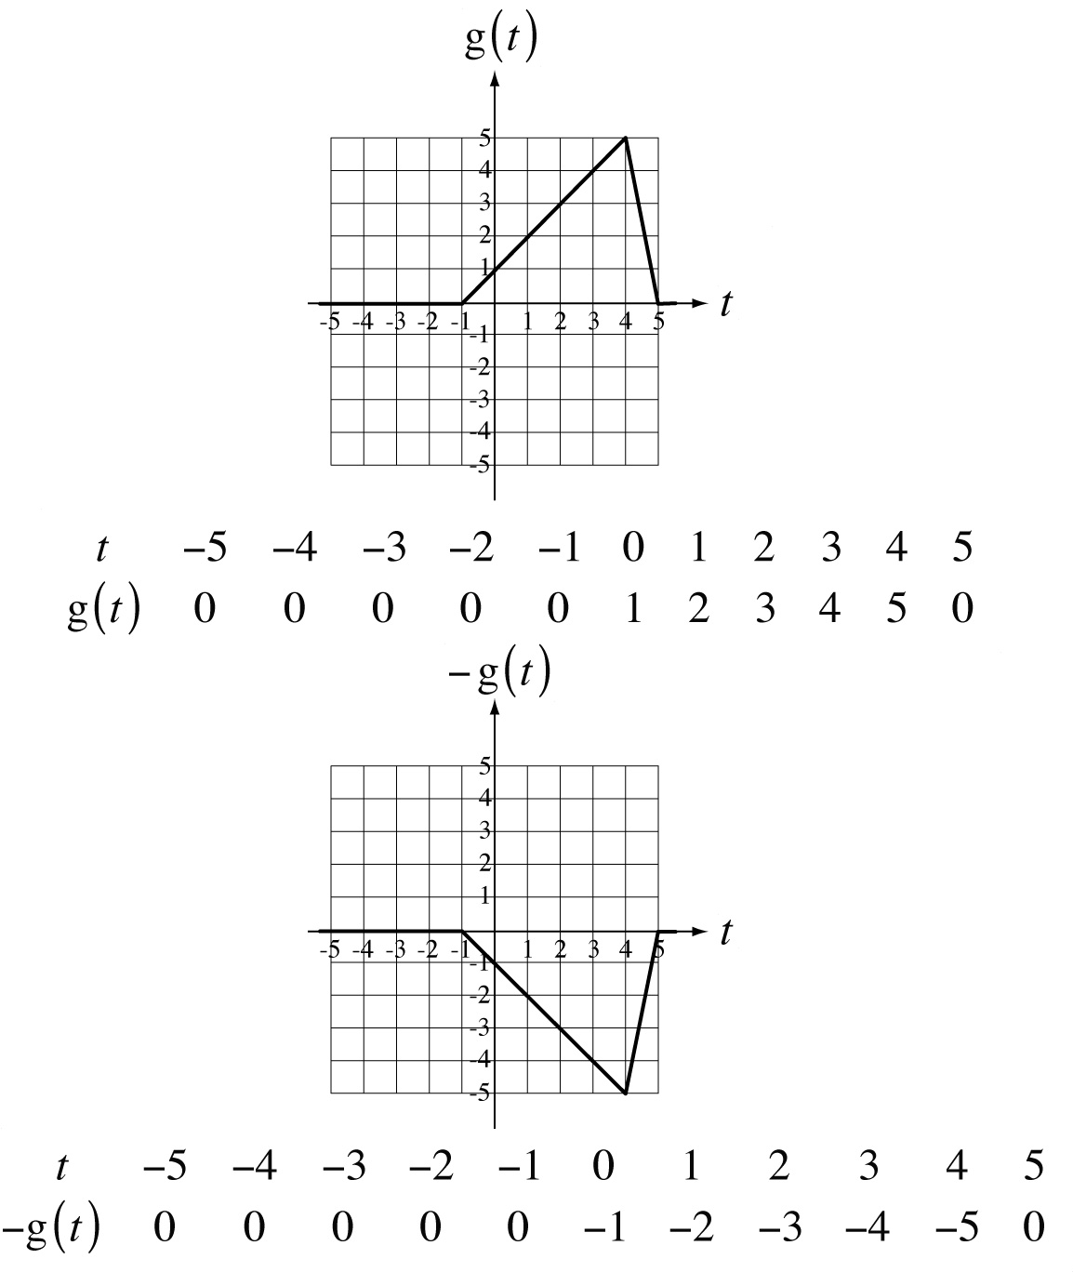
Shifting and Scaling Functions
Amplitude Scaling,
M. J. Roberts - All Rights Reserved. Edited by Dr. Robert Akl
‹#›

Slide 23
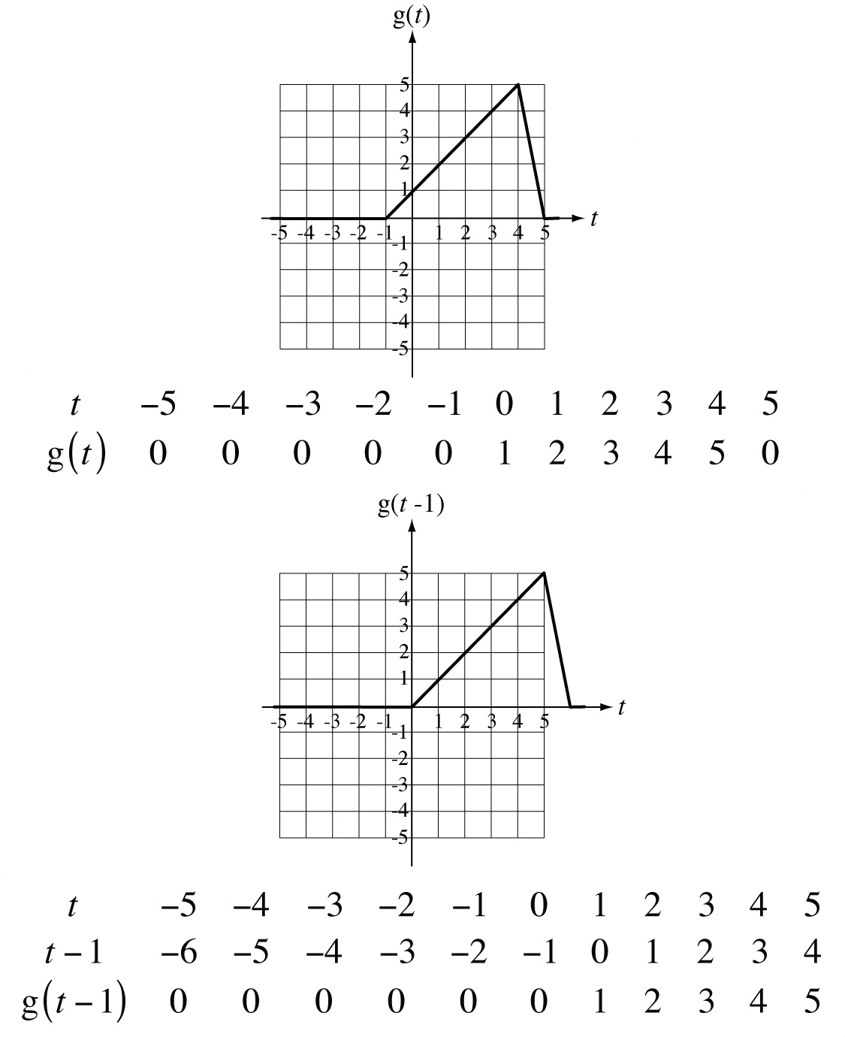
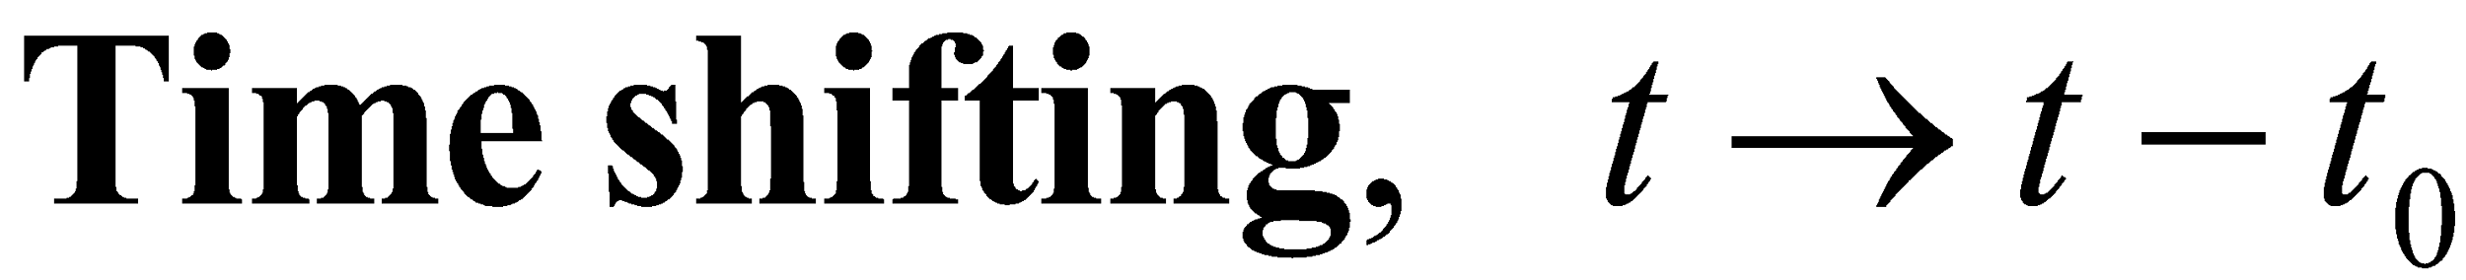
Shifting and Scaling Functions
M. J. Roberts - All Rights Reserved. Edited by Dr. Robert Akl
‹#›

Slide 24
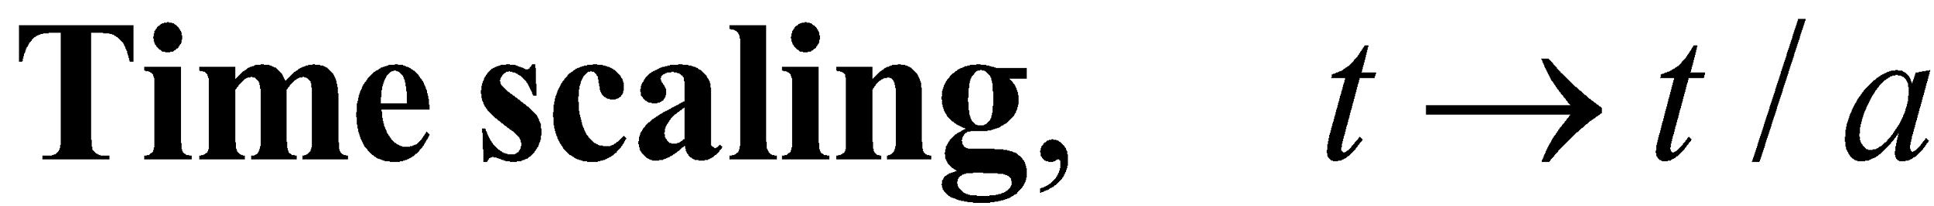
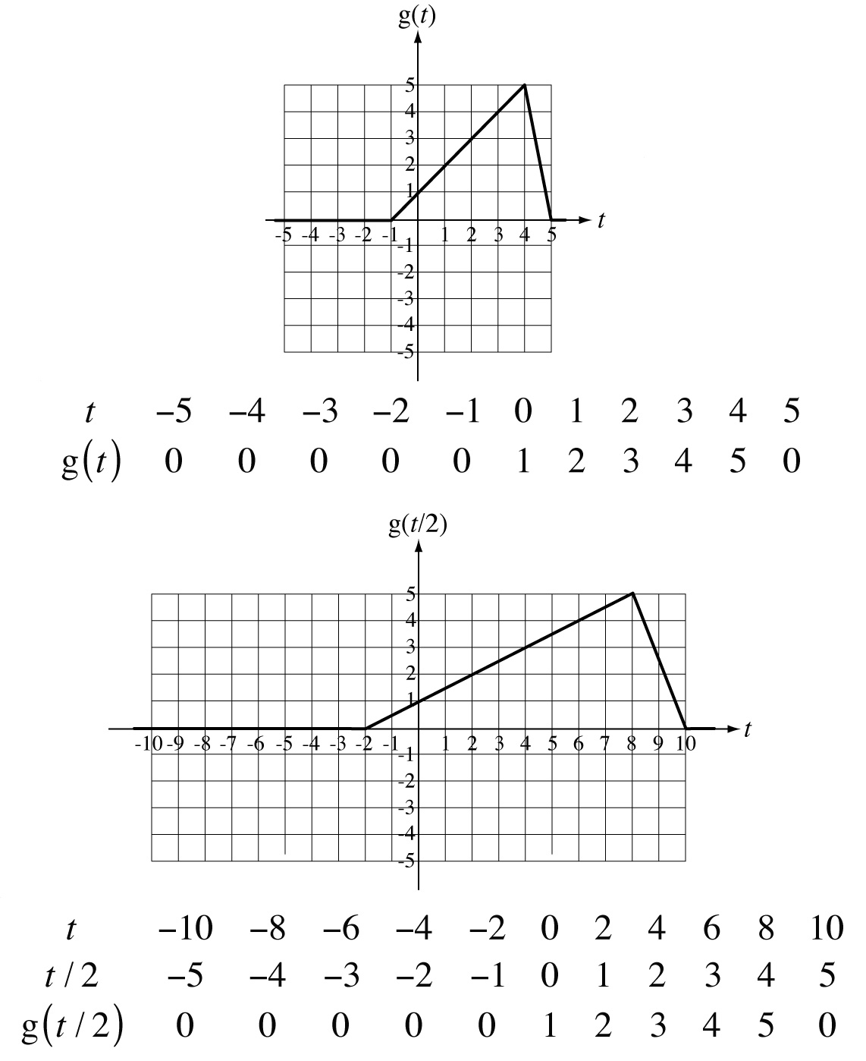
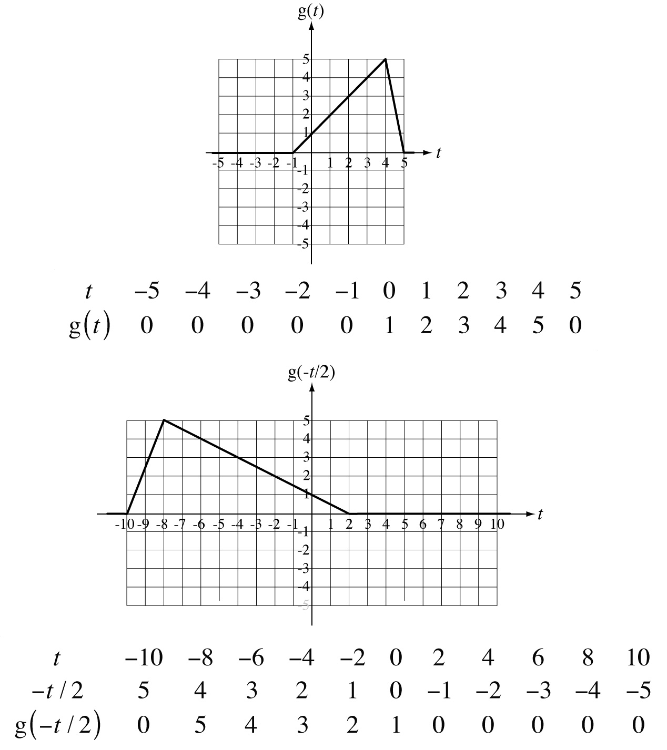
Shifting and Scaling Functions
M. J. Roberts - All Rights Reserved. Edited by Dr. Robert Akl
‹#›

Slide 25
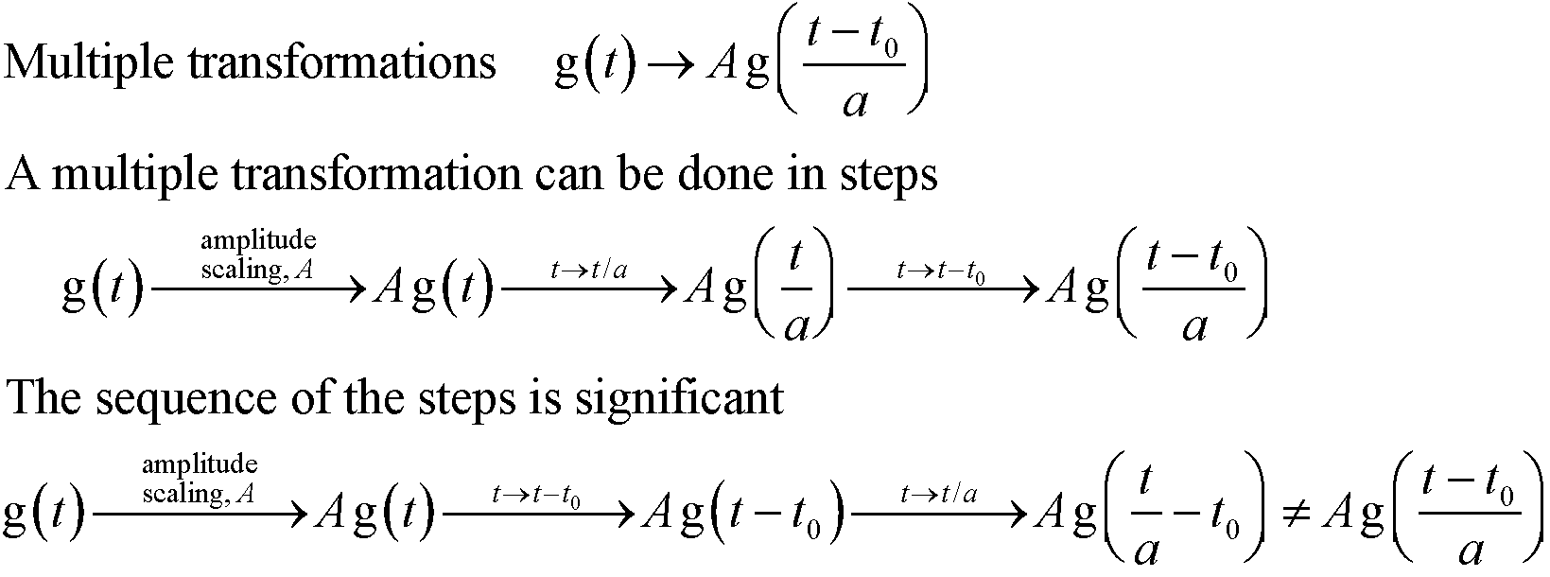
Shifting and Scaling Functions
M. J. Roberts - All Rights Reserved. Edited by Dr. Robert Akl
‹#›

Slide 26
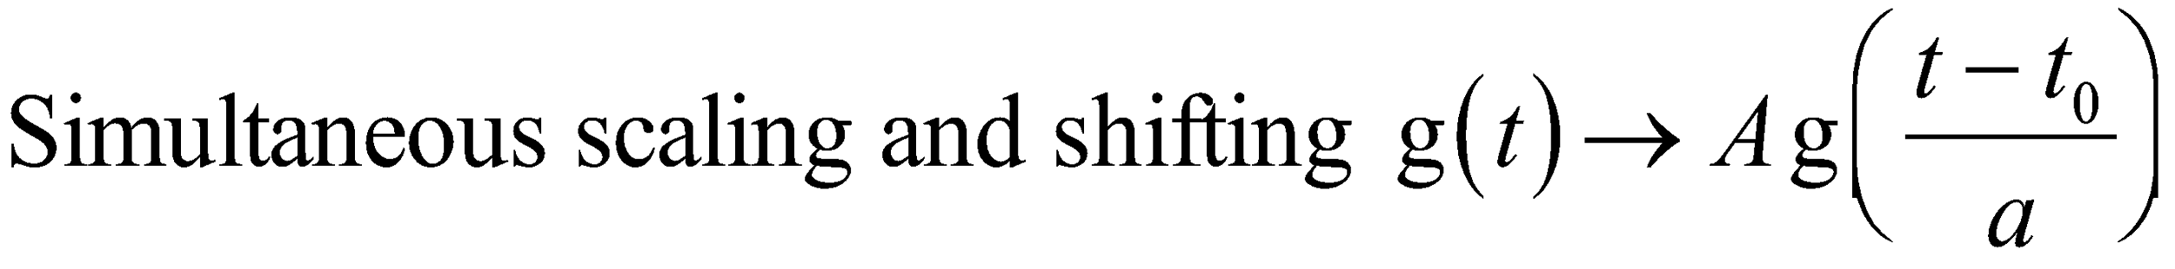
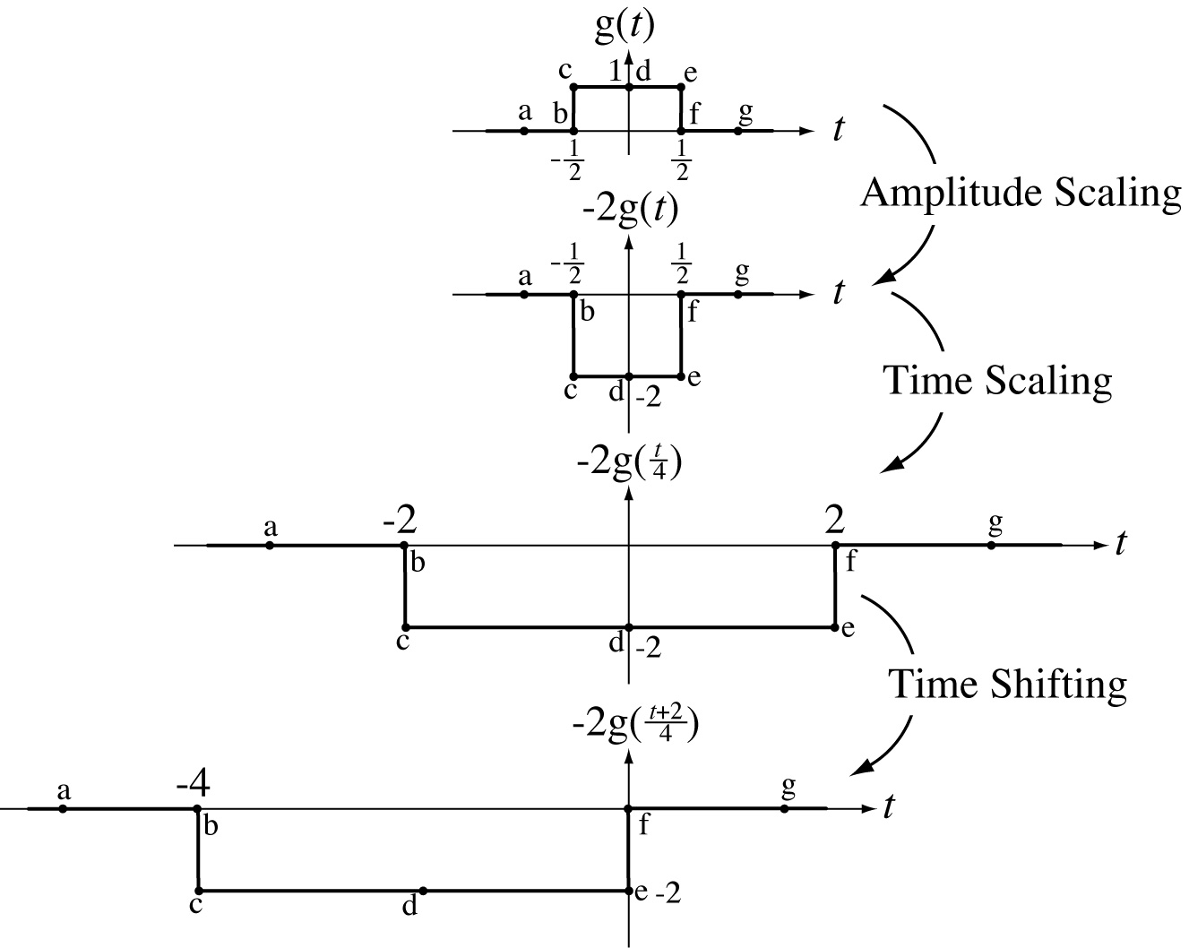
Shifting and Scaling Functions
M. J. Roberts - All Rights Reserved. Edited by Dr. Robert Akl
‹#›

Slide 27
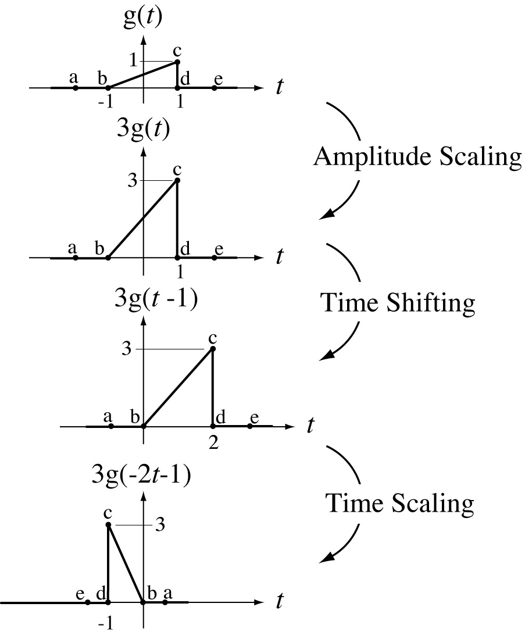
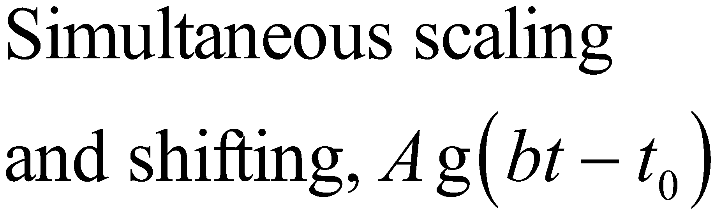
Shifting and Scaling Functions
M. J. Roberts - All Rights Reserved. Edited by Dr. Robert Akl
‹#›

Slide 28
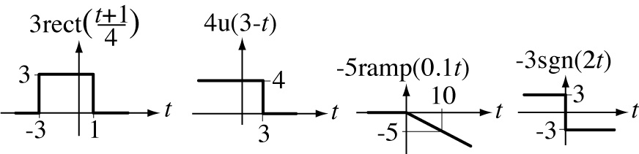
Shifting and Scaling Functions
M. J. Roberts - All Rights Reserved. Edited by Dr. Robert Akl
‹#›

Slide 29
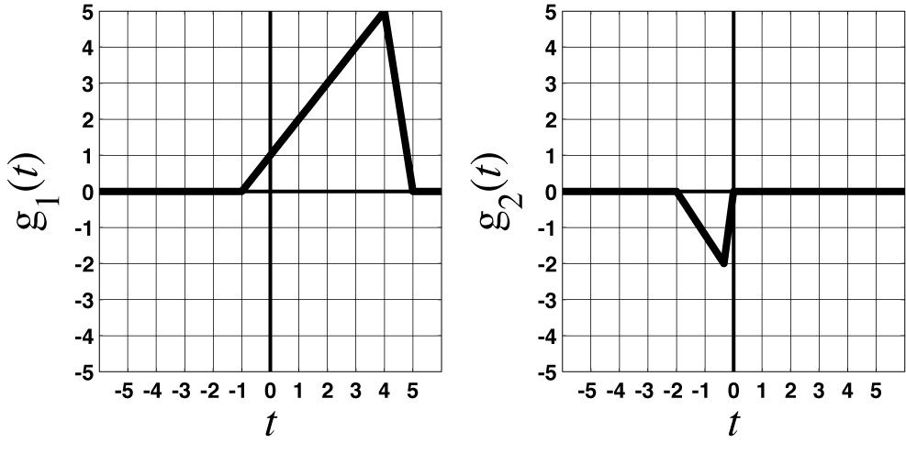
Shifting and Scaling Functions
M. J. Roberts - All Rights Reserved. Edited by Dr. Robert Akl
‹#›

Slide 30
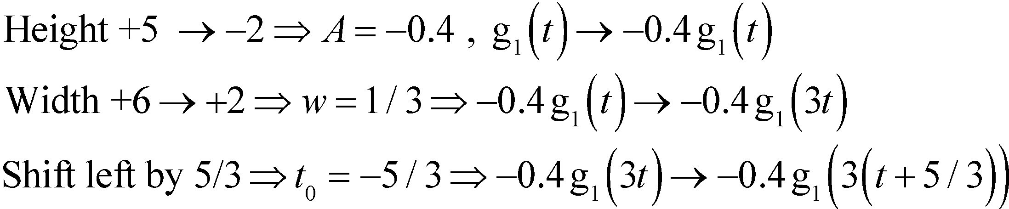

Shifting and Scaling Functions
M. J. Roberts - All Rights Reserved. Edited by Dr. Robert Akl
‹#›

Slide 31
Shifting and Scaling Functions
M. J. Roberts - All Rights Reserved. Edited by Dr. Robert Akl
‹#›

Slide 32


Shifting and Scaling Functions
M. J. Roberts - All Rights Reserved. Edited by Dr. Robert Akl
‹#›

Slide 33

Shifting and Scaling Functions
M. J. Roberts - All Rights Reserved. Edited by Dr. Robert Akl
‹#›

Slide 34


Shifting and Scaling Functions
M. J. Roberts - All Rights Reserved. Edited by Dr. Robert Akl
‹#›

Slide 35
Shifting and Scaling Functions
M. J. Roberts - All Rights Reserved. Edited by Dr. Robert Akl
‹#›

Slide 36


Shifting and Scaling Functions
M. J. Roberts - All Rights Reserved. Edited by Dr. Robert Akl
‹#›

Slide 37

Differentiation
M. J. Roberts - All Rights Reserved. Edited by Dr. Robert Akl
‹#›

Slide 38

Integration
M. J. Roberts - All Rights Reserved. Edited by Dr. Robert Akl
‹#›

Slide 39



Even and Odd Signals
M. J. Roberts - All Rights Reserved. Edited by Dr. Robert Akl
‹#›

Slide 40

Even and Odd Parts of Functions
M. J. Roberts - All Rights Reserved. Edited by Dr. Robert Akl
‹#›

Slide 41


Even and Odd Parts of Functions
M. J. Roberts - All Rights Reserved. Edited by Dr. Robert Akl
‹#›

Slide 42

Products of Even and Odd Functions
Two Even Functions
M. J. Roberts - All Rights Reserved. Edited by Dr. Robert Akl
‹#›

Slide 43

Products of Even and Odd Functions
An Even Function and an Odd Function
M. J. Roberts - All Rights Reserved. Edited by Dr. Robert Akl
‹#›

Slide 44

Products of Even and Odd Functions
An Even Function and an Odd Function
M. J. Roberts - All Rights Reserved. Edited by Dr. Robert Akl
‹#›

Slide 45

Products of Even and Odd Functions
Two Odd Functions
M. J. Roberts - All Rights Reserved. Edited by Dr. Robert Akl
‹#›

Slide 46


Integrals of Even and Odd Functions
M. J. Roberts - All Rights Reserved. Edited by Dr. Robert Akl
‹#›

Slide 47

Integrals of Even and Odd Functions
M. J. Roberts - All Rights Reserved. Edited by Dr. Robert Akl
‹#›

Slide 48

Periodic Signals
A function that is not periodic is aperiodic.
M. J. Roberts - All Rights Reserved. Edited by Dr. Robert Akl
‹#›

Slide 49


Sums of Periodic Functions
The period of the sum of periodic functions is the least common
multiple of the periods of the individual functions summed. If the
least common multiple is infinite, the sum function is aperiodic.
M. J. Roberts - All Rights Reserved. Edited by Dr. Robert Akl
‹#›

Slide 50

ADC Waveforms
Examples of waveforms which
may appear in analog-to-digital converters. They can be described by a periodic repetition of a ramp returned to zero by a negative step or by a periodic repetition of a triangle-shaped function.
M. J. Roberts - All Rights Reserved. Edited by Dr. Robert Akl
‹#›

Slide 51

Signal Energy and Power
M. J. Roberts - All Rights Reserved. Edited by Dr. Robert Akl
‹#›

Slide 52

Signal Energy and Power
M. J. Roberts - All Rights Reserved. Edited by Dr. Robert Akl
‹#›

Slide 53

Signal Energy and Power
M. J. Roberts - All Rights Reserved. Edited by Dr. Robert Akl
‹#›

Slide 54

Signal Energy and Power
M. J. Roberts - All Rights Reserved. Edited by Dr. Robert Akl
‹#›

Slide 55
Signal Energy and Power
A signal with finite signal energy is
called an energy signal.
A signal with infinite signal energy and
finite average signal power is called a
power signal.
M. J. Roberts - All Rights Reserved. Edited by Dr. Robert Akl
‹#›

Slide 56


Signal Energy and Power
M. J. Roberts - All Rights Reserved. Edited by Dr. Robert Akl
‹#›

